Slide 1

Advanced Big Data Analysis Efficient Computation of PageRank and Topic-Sensitive Page Rank
14.10.2024
Niklas Mezger
Student Number: 202450049

Slide 2
The Challenge: Computing PageRank at Web Scale
The main challenges we face when computing PageRank are:
1. Size of the Web:
• The web contains billions of pages
• The transition matrix would be enormous - billions by billions
• Most entries in this matrix would be zero
2. Memory Limitations:
• Even modern computers cannot hold the entire matrix in memory
• Loading parts from disk is too slow (called thrashing)
• We need smart solutions to handle these limitations
Notes:
Zusammenfassung in einem Satz: This measure measures the importance of words within documents.

Slide 3
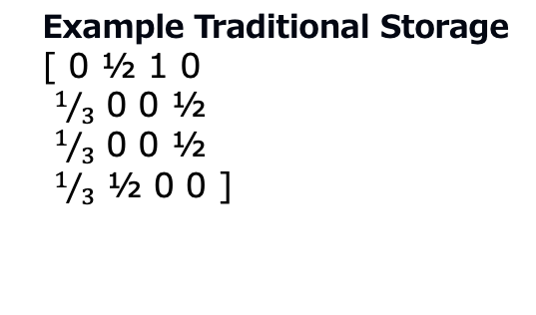
Solution Part 1: Efficient Matrix Storage
Instead of storing the entire matrix, we can store it more efficiently:
For each web page, we only store:
• The total number of outgoing links (out-degree)
• The list of pages it links to (destinations)
This saves enormous amounts of space because:
• We don't store any zero entries
• We don't repeatedly store the same fraction (1/degree)
Example Traditional Storage
[ 0 ½ 1 0
$1/3$ 0 0 ½
$1/3$ 0 0 ½
$1/3$ ½ 0 0 ]
Example Efficient Storage
Page A: degree=3, links to → [B, C, D]
Page B: degree=2, links to → [A, D]
Page C: degree=1, links to → [A]

Slide 4
Solution Part 2: The Block-Stripe Method
To handle large matrices, we divide them into smaller blocks:
How it works:
• Divide the matrix into k² blocks
• Each block handles a portion of the source pages and destination pages
• Blocks can be processed independently
Benefits:
• Each block is small enough to fit in memory
• Can process blocks in parallel on different machines
• Reduces the amount of data that needs to be transferred

Slide 5
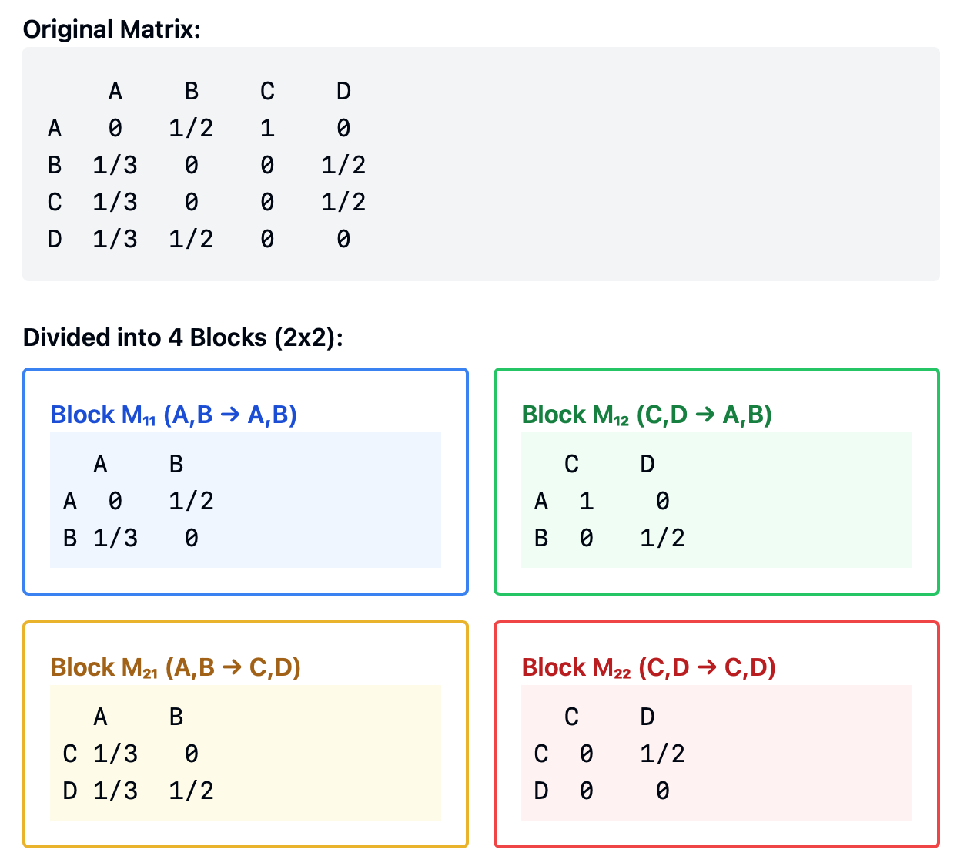
Block-Stripe Method: A Practical Example
Let's look at how we divide a matrix for a small web with 4 pages (A, B, C, D):
How it works:
• Each block represents links between a specific group of source and destination pages
• Block M₁₁: Links from A,B to A,B
• Block M₁₂: Links from C,D to A,B
• Block M₂₁: Links from A,B to C,D
• Block M₂₂: Links from C,D to C,D

Slide 6
How Topic-Sensitive PageRank Works
Instead of one PageRank, we compute multiple PageRanks:
1. Choose different topics (like sports, technology, cooking)
2. For each topic:
• Identify trusted pages about that topic
• Make random surfers prefer these pages
• Calculate a special PageRank for this topic
When a user searches:
1. Determine the likely topic of their search
2. Use the corresponding topic-specific PageRank
3. Return more relevant results

Slide 7
Implementing Topic-Sensitive PageRank
Step 1: Creating Topic Sets
• Use established directories like DMOZ
• Choose 16-20 major topics
• Identify key pages for each topic
Step 2: Modified Random Walk
• Random surfers teleport only to topic pages
• Formula: v' = βMv + (1-β)eₛ/|S|
• S is the set of pages about the topic
Step 3: Query Processing
• Analyze query words
• Match to most relevant topic
• Use corresponding PageRank vector

Slide 8
Summary
For Efficient Computation:
• Store matrices sparsely
• Use block-stripe method
• Distribute computation across machines
For Topic Sensitivity:
• Create multiple PageRank vectors
• Use topic-specific teleport sets
• Match queries to topics
Together, these improvements make search engines:
• More scalable
• More efficient
• More relevant to users

Slide 9
Thanks for listening!

